Slide 1
Final Intern Presentation:
Investigating Fits of Site Frequency Spectrum (SFS) Curves
Bobby Yang
08/04/22

Slide 2
Overview
“Statistical Inference for the Evolutionary History of Cancer Genomes”
Use models to explain and infer info about cancer evolution (mutation, growth, etc.)
Branching process - given birth, death, mutation rates
Effects of parameters (esp. false negatives), data collection methods
Fit equations to real data

Slide 3
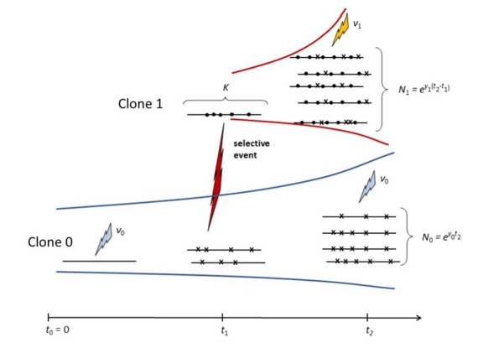
Simulation
Series of R scripts, Khanh N. Dinh, Columbia
Start with 1 cell at t = 0, given birth/death, mutation rates
At t = t1, clone appears with different mutation rate
At t = t2, “diagnosis”, cells are sampled, data collected

Slide 4
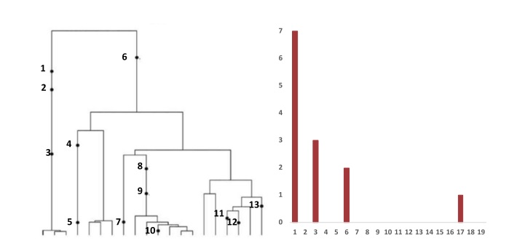
SFS
Summary statistic for models
Numerical vector: at kth index, how many mutation sites have k cells mutated
Examine fit of theoretical equation from paper, to empirical distr. of data

Slide 5
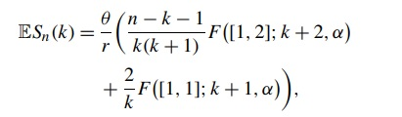
Lambert equation
Equation to fit curve to SFS histogram
Hypergeometric functions F([x,y]; k, alpha)
Theta = mutation rate
r = birth-death
k = index on SFS plot
n = number of cells in sample
Alpha = 1-(fraction of sample to total*birth/r)

Slide 6
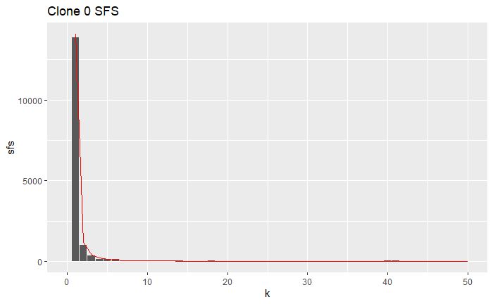
Base fit, no errors
Relatively good fit, no FP, FN, NA, etc

Slide 7
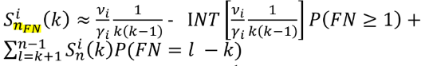
False negatives transformation
Original equation
Subtract by E(x) of false negatives
Add by sum of false negatives from greater k

Slide 8
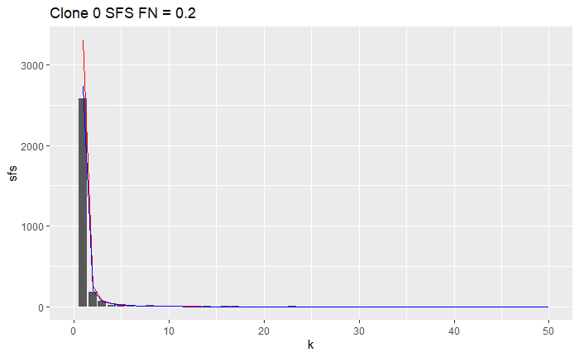

Slide 9
Mixed clones plot
Don’t separate clones 0 and 1, sum together
“Hump” due to clone 1 carrying its mutation to all its progeny
Group of mutations with all cells from clone 1

Slide 10

Mixed clones equation
Clone 0 fit
Clone 1 fit
Hump
Weighted sum of both fits
p0 = proportion of cells in clone 0
p1 = proportion of cells in clone 1
Binomial term - clone 1
n = number of cells in sample
k = index for SFS
K = scalar optimized to fit SFS
Afterward, use FN transform before

Slide 11
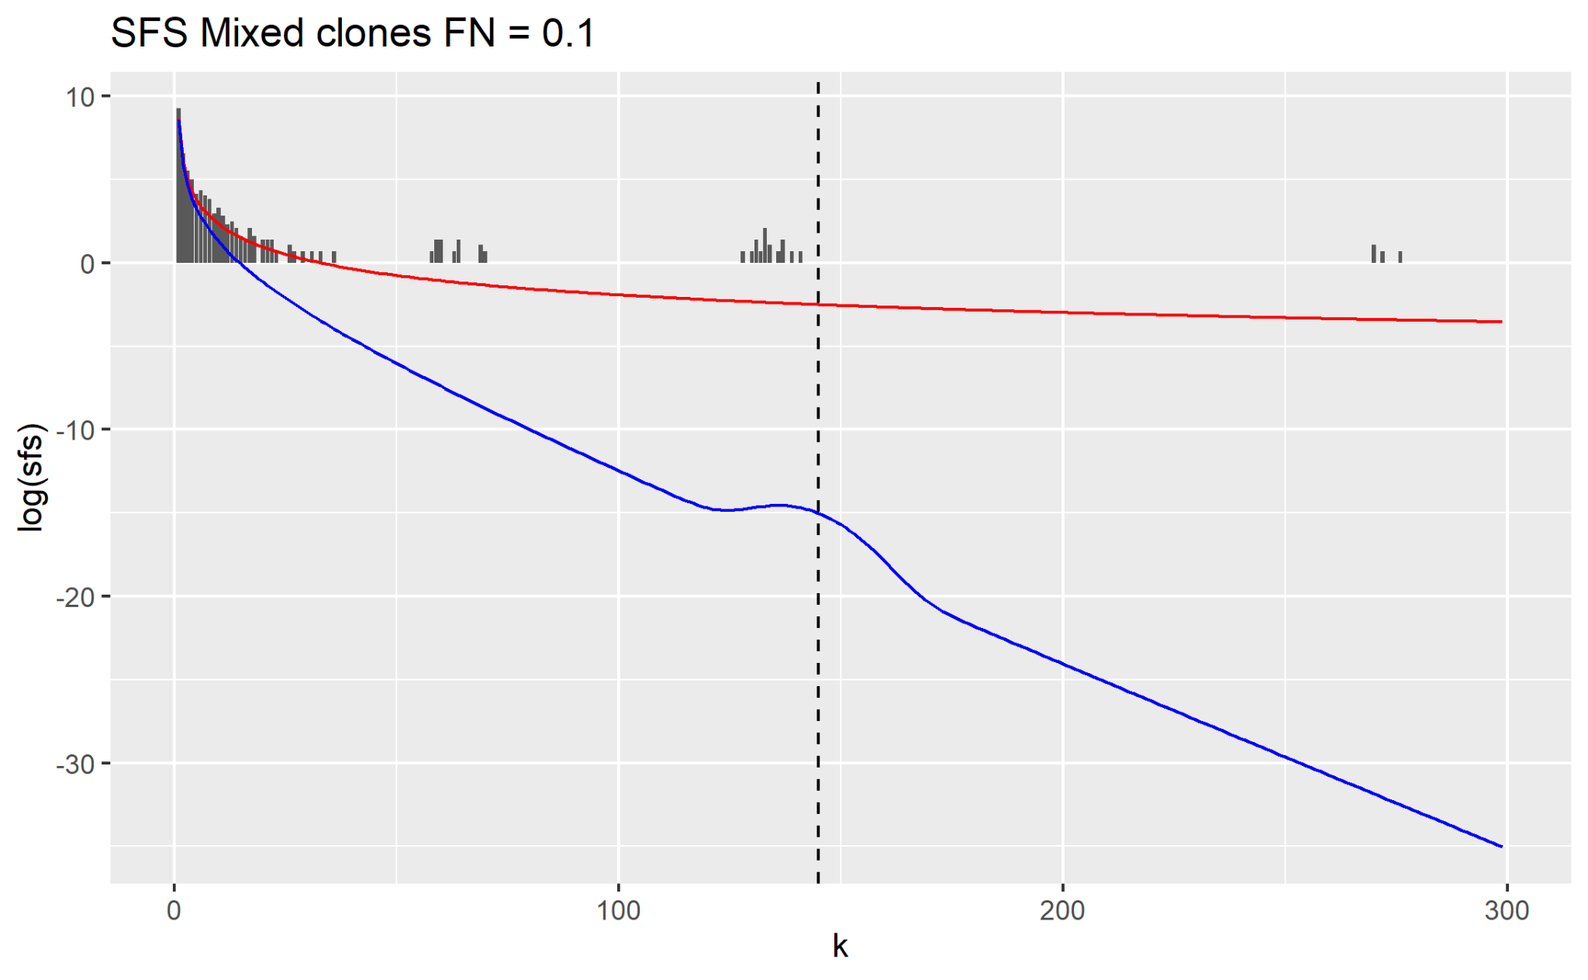

Slide 12
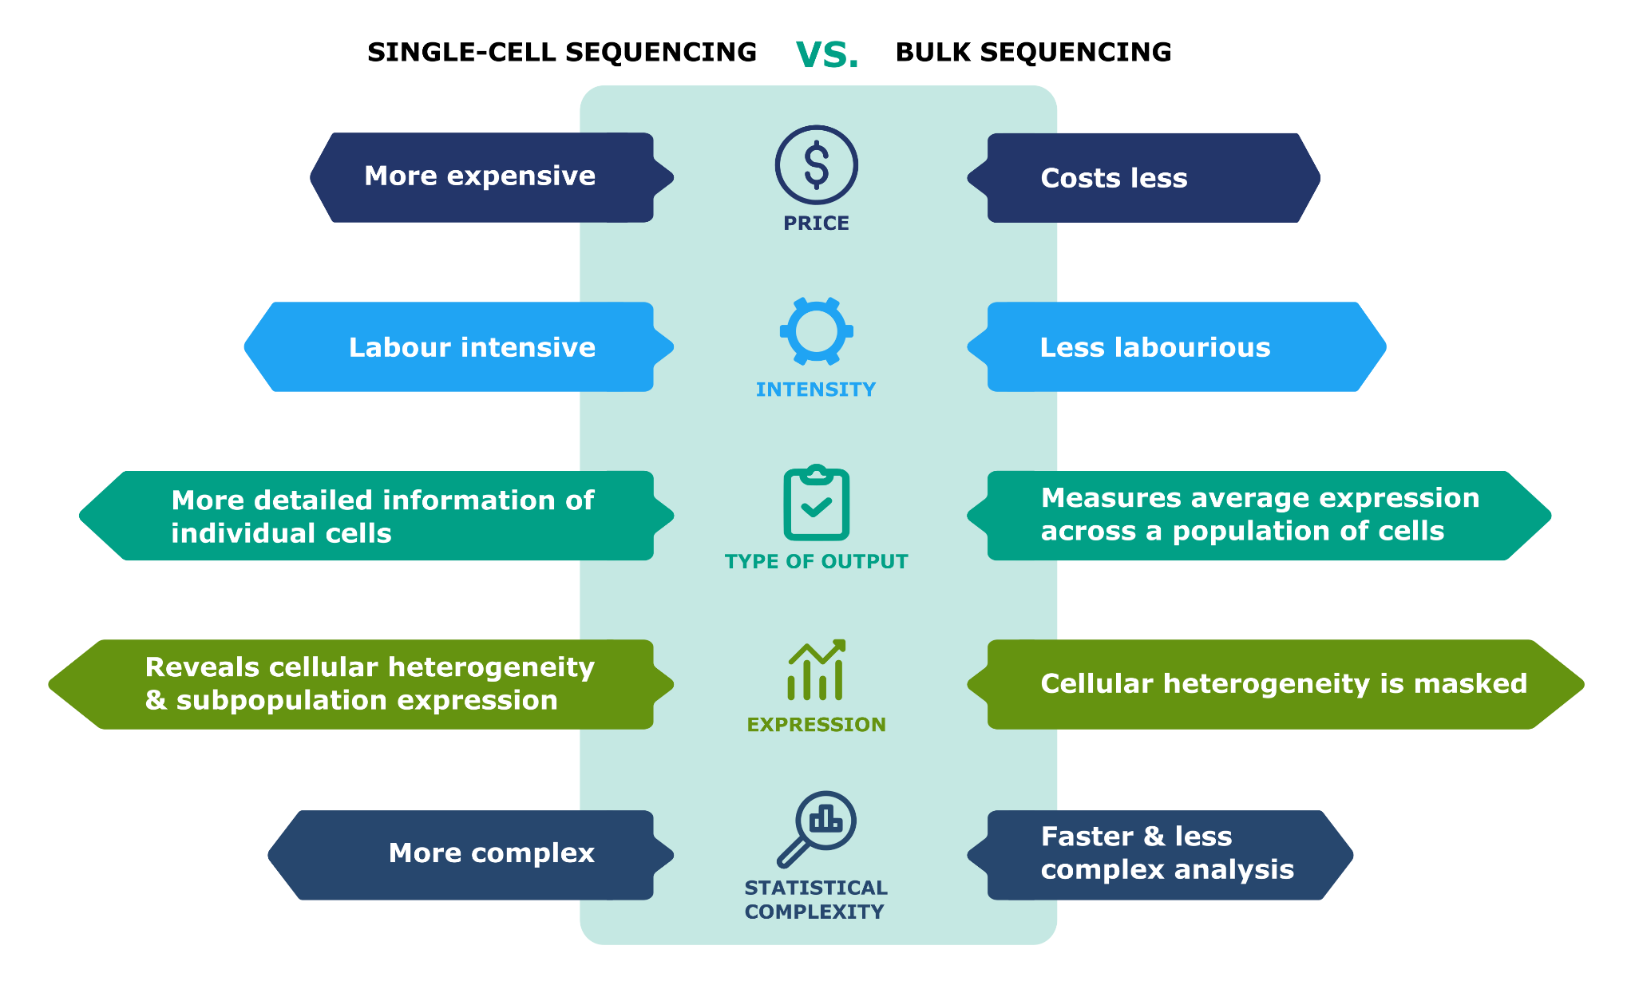
Bulk sequencing data
Single cell: tells info about each individual cell at each mutation site
Bulk: only gives average expression

Slide 13
Simulation
Takes truth data (no errors), adds errors/NA values, create pseudo-bulk
Has an SFS for each dataset, for each FN rate, for each clone

Slide 14
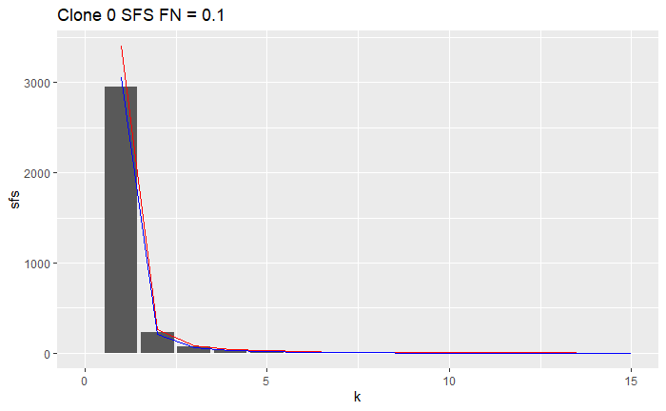
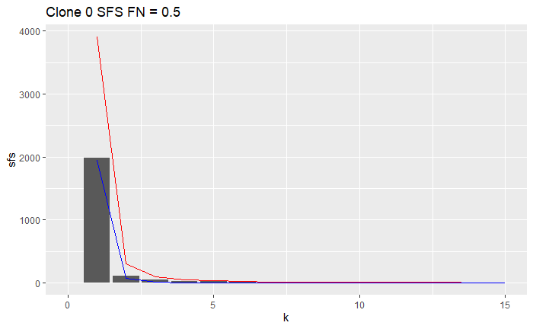
Bulk sequence plots

Slide 15
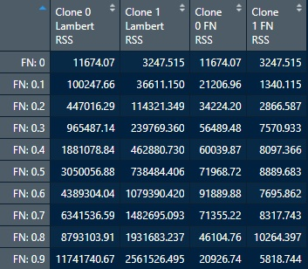
Average RSS values
Assess fit of FN equation numerically
Parallelize code, run on 40 datasets, take averages
NOTS supercomputer cluster attempted, failed

Slide 16
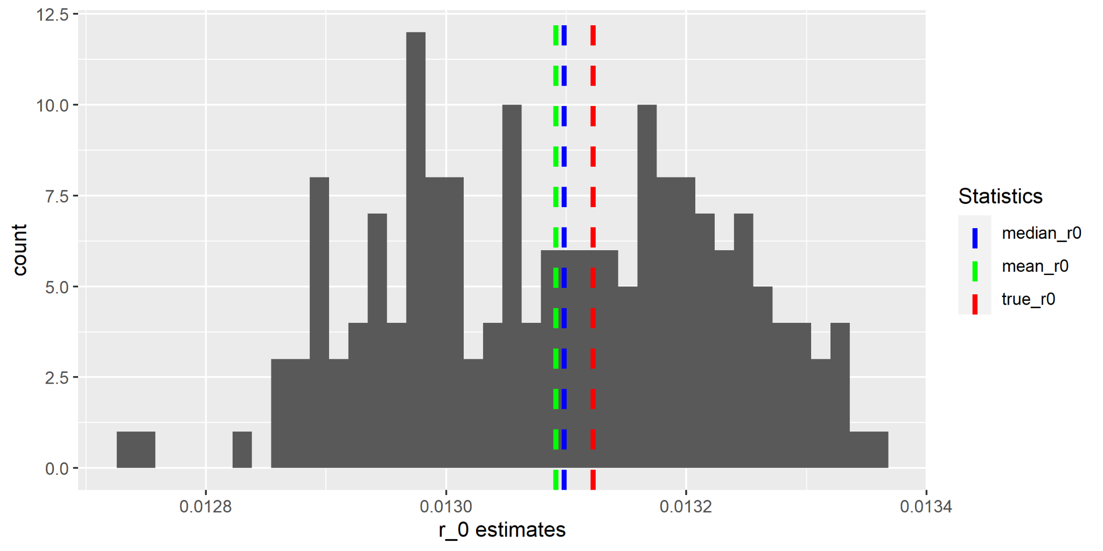
Next steps - Estimating parameters
Andrew sends batches of datasets (200-250 per parameter combination)
Theta0, theta1, t1
Use his code to generate plots
See effects of changing parameters on estimation

Slide 17
Next steps - Imputation
Try Amelia
Currently using fraction of 1’s in non-NA (1/0)
Approximates for row sums, doesn’t account for FP/FN

